Slide 1

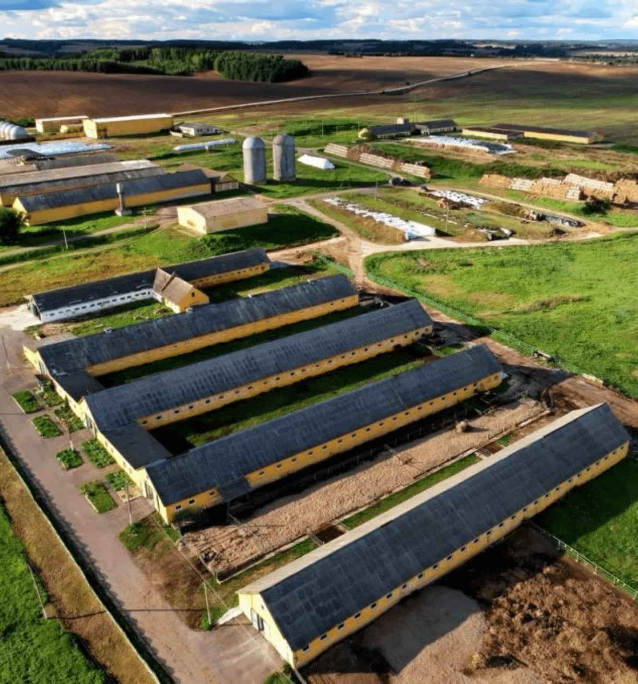
Design Strategy for the Farm Security & Fencing Module
Excellence Program – Week 2
PREPARED BY
Tania

Slide 2




From Review to Strategy
WEEK 1
WEEK 2
FUTURE WEEKS
Critical Review
Design Strategy
Implementation
Focused on understanding the previous team's work, identifying gaps, and extracting key lessons from past failures.
Establishes the methodology and design principles that will govern all future engineering decisions.
Execution of the design plan, zone division, access-control workflows, and physical infrastructure setup.

Slide 3


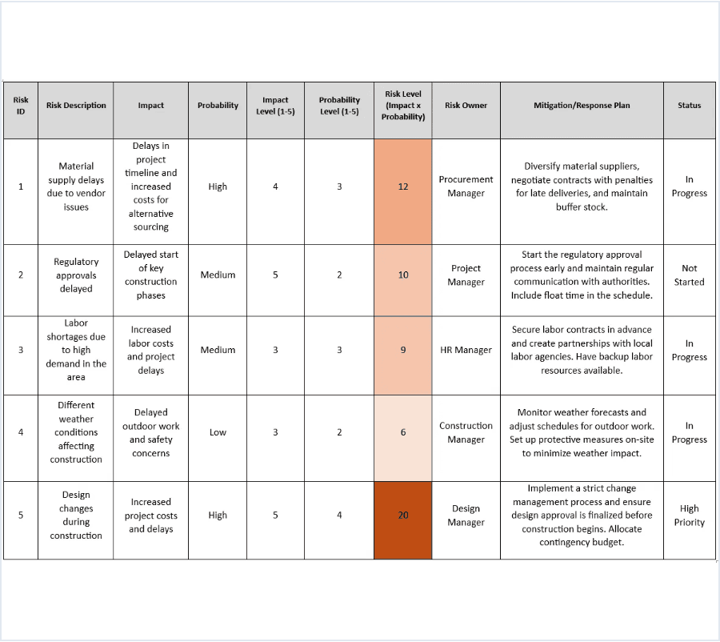




Engineering Insights: Key Lessons from Week 1
Implementability is Paramount
A design is only as good as its feasibility in the field and ease of maintenance.
Holistic Security
True security integrates people, processes, and technology into a unified defense.
Modular Synergy
Individual components must function as a cohesive, interoperable system.
Environmental Context
Local terrain and climate conditions dictate hardware selection and placement.
Risk-First Approach
EXAMPLE: RISK ASSESSMENT FRAMEWORK
Planning must start with threat assessment before selecting specific equipment.

Slide 4






A Deliberate Design Strategy
OBSERVE
UNDERSTAND
DESIGN
EVALUATE
IMPROVE
Conduct site assessments and identify environmental constraints.
Analyze specific threats and asset vulnerabilities.
Develop integrated solutions prioritizing prevention.
Test assumptions against practical requirements.
Iterate based on feedback and performance metrics.
Establishing a structured engineering methodology before selecting technical hardware.

Slide 5


Development Roadmap
PHASE 01
PHASE 02
PHASE 03
PHASE 04
Understand
Design
Organize
Evaluate
Deep dive into requirements, site assessment, and environmental analysis to define the problem space.
Drafting the integrated architecture, security zones, and selecting appropriate hardware solutions.
Planning operational workflows, physical infrastructure deployment, and maintenance schedules.
Feasibility analysis, risk mitigation review, and final architectural reflection before execution.
"A strong security system is not built by adding more technology. It is built by making deliberate decisions in the right order."

